Slide 1
Kinetic Framework

Slide 2
Why Kinetic?

Slide 3
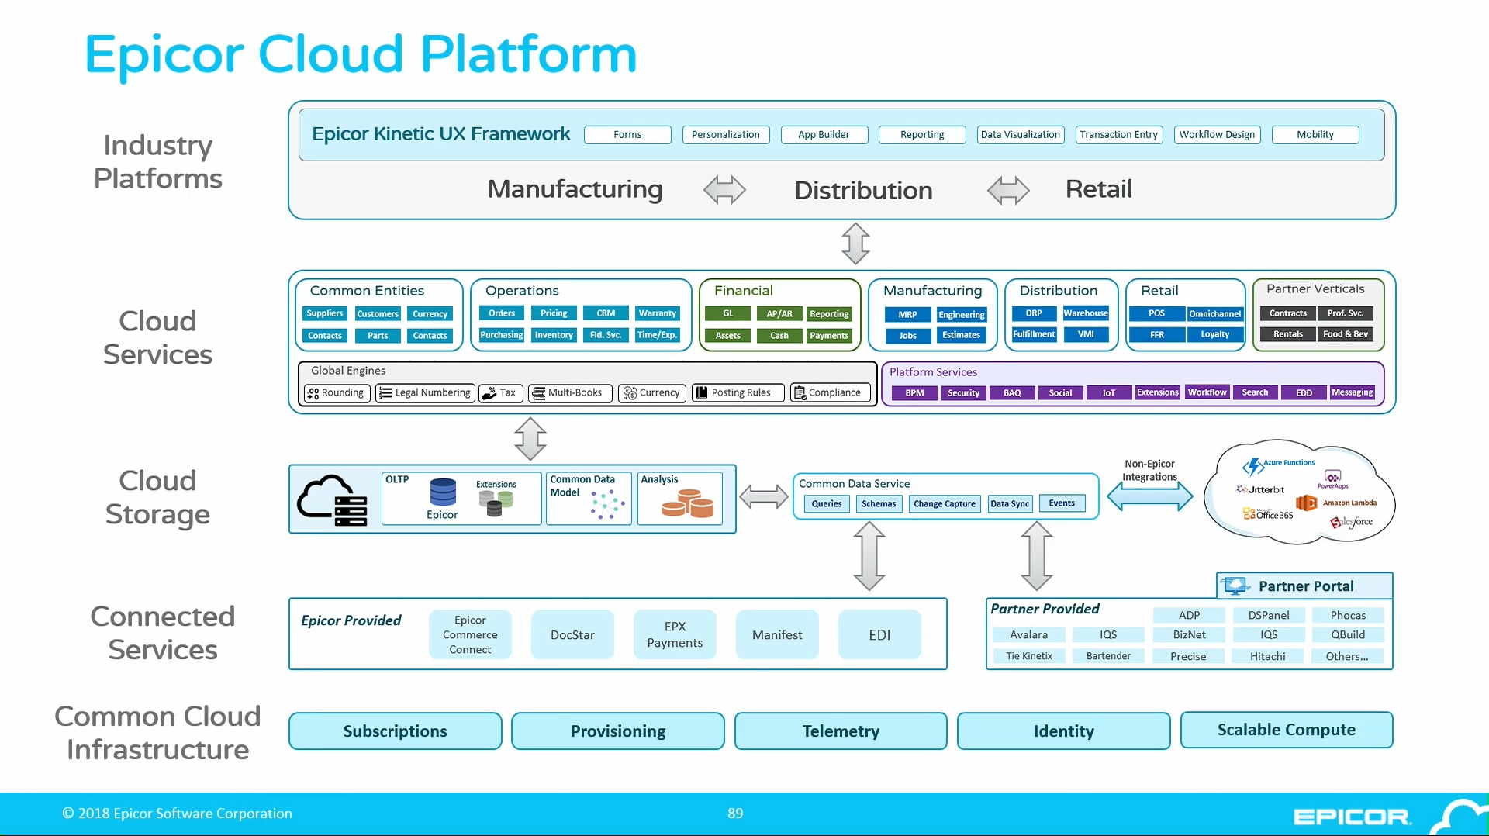
Notes:
https://vimeopro.com/creative454/2018-insights/video/271352861

Slide 4
Testharness
https://kinetic.developer.epicor.com/framework/

Slide 5
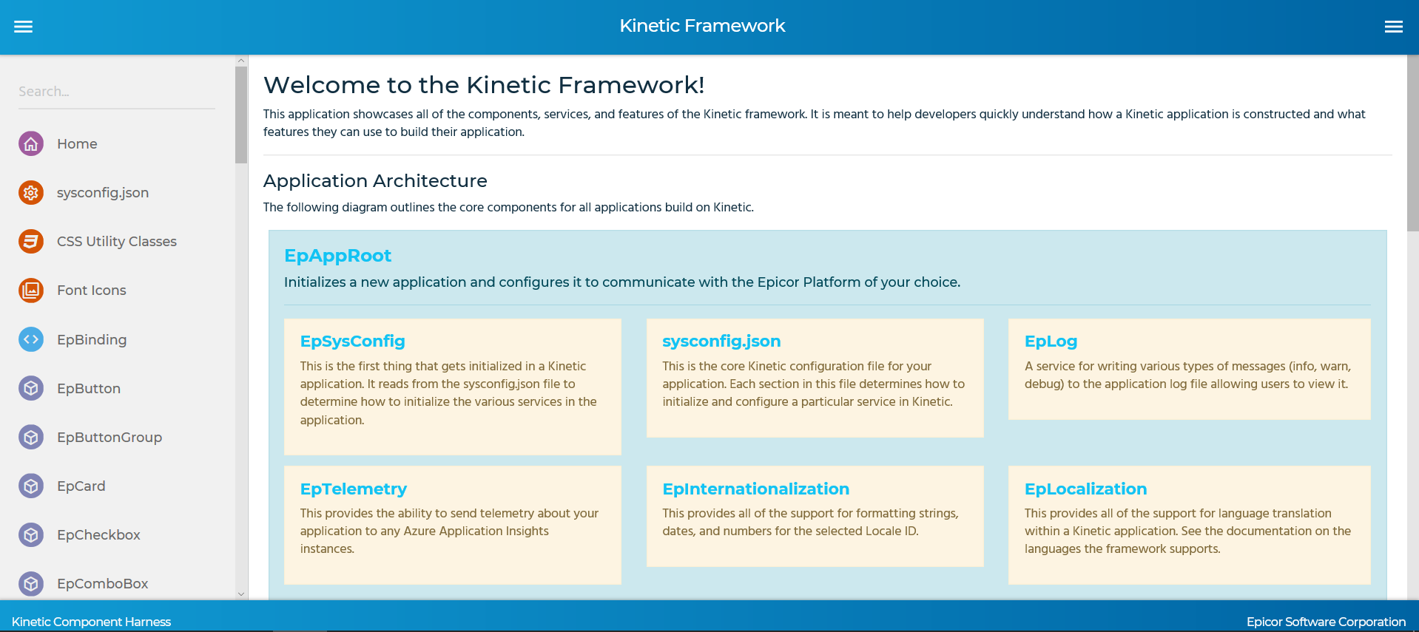

Slide 6
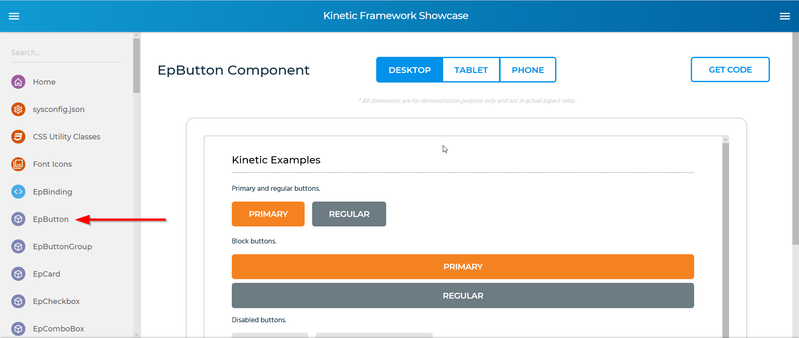

Slide 7
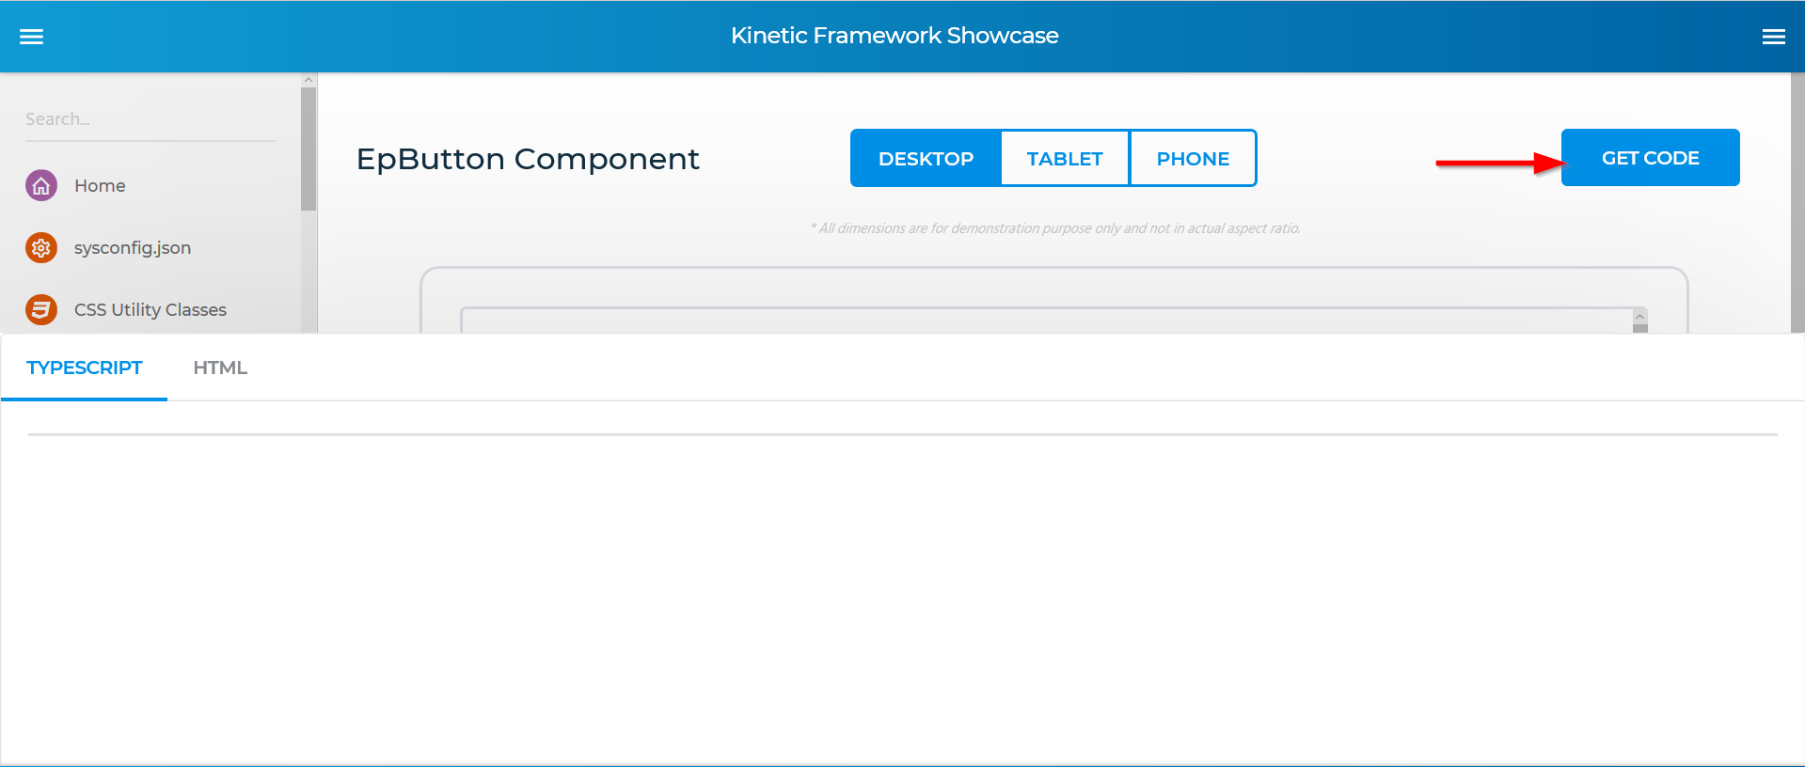

Slide 8
Technology
Angular 6.x
Kendo control
Notes:
Source code in GIT
https://epicor-corp.visualstudio.com/DefaultCollection/Epicor-Mobile/_git/EXF

